Slide 1


Introduction to Power BI
Trainer –Naveen Mishra

Slide 2







MNC & Indian Corporate Customers

Slide 3

Qualification
Master in Computer Application (MCA)
Advanced Diploma of Computer Application (ADCA) -2002 (IGNOU)
Bachelor in Computer Application (BCA) -2001 (IGNOU)
O Level From DOEACC, New Delhi - 2000
DCPA (Diploma in Computer & Programming Application) -TATA InfoTech -1999
Microsoft Office Specialist 2016 - Microsoft
20 years of experience of MS Office training & Consulting

Slide 4
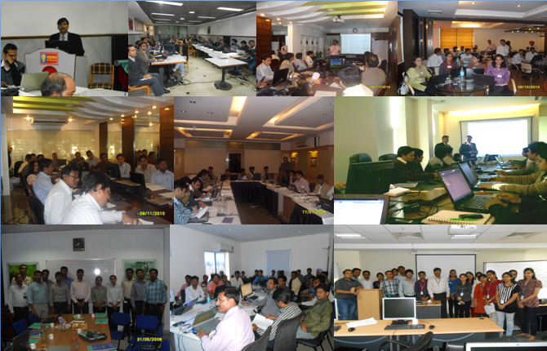
Our Motto : Learn, Practice & Master….

Slide 5
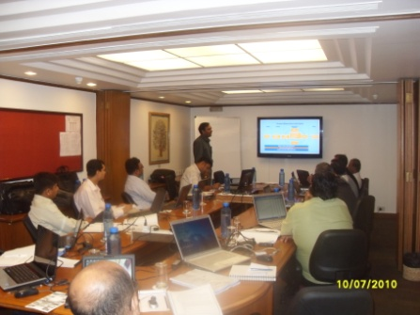


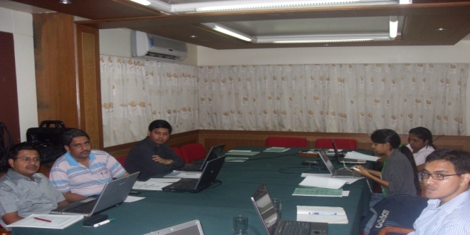


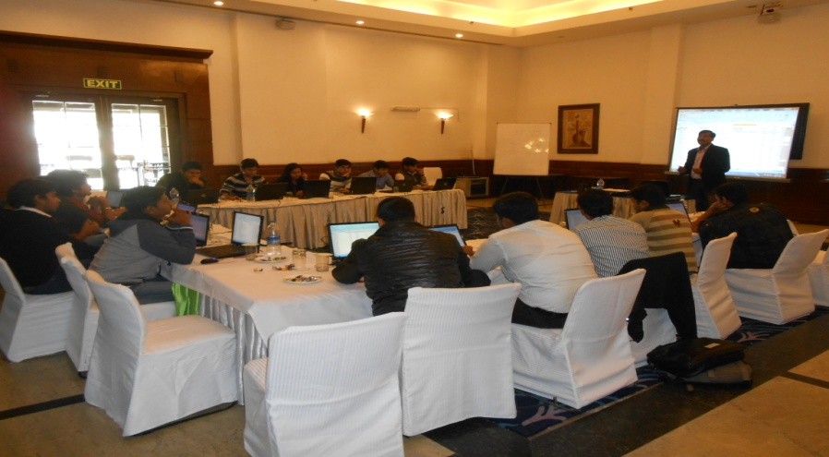



Our Motto : Learn, Practice & Master….

Slide 6

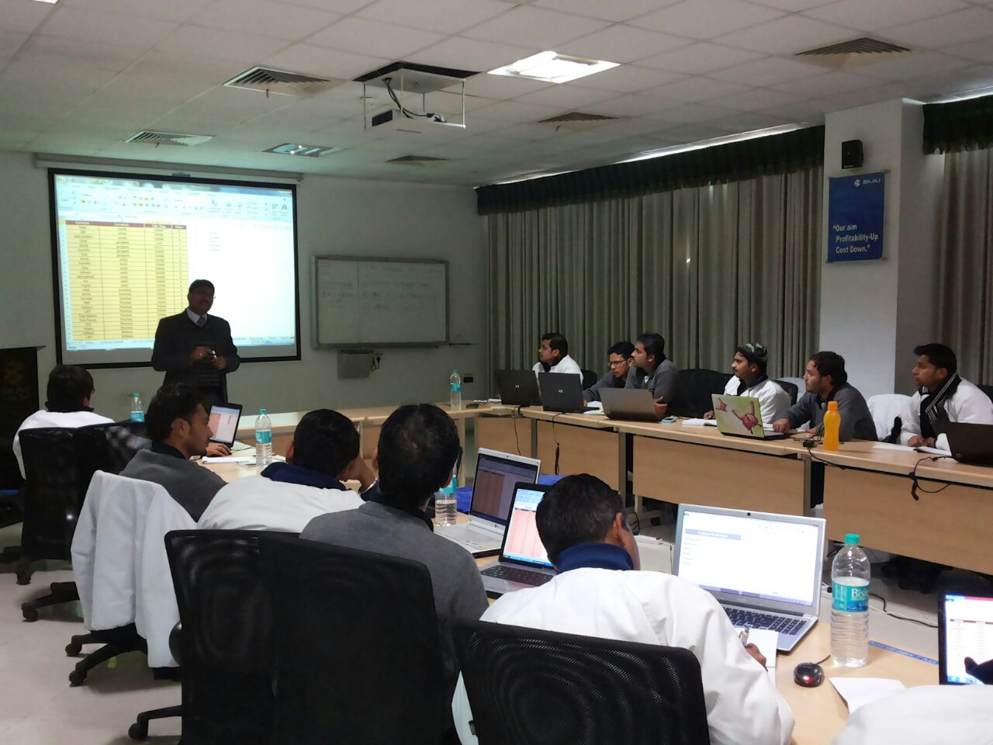




Slide 7

My Motto : Learn, Practice & Master….

Slide 8


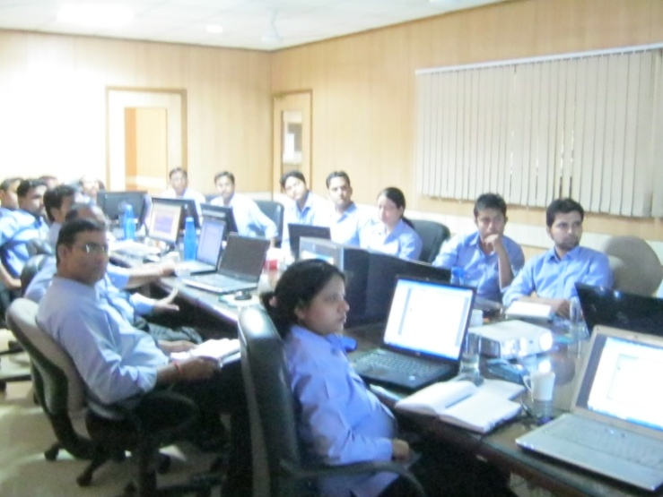


My Motto : Learn, Practice & Master….

Slide 9
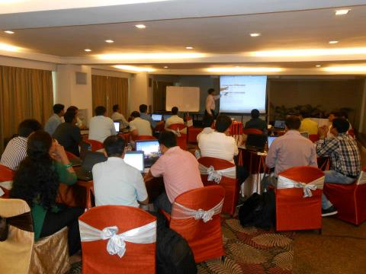




My Motto : Learn, Practice & Master….

Slide 10


My Motto : Learn, Practice & Master….

Slide 11


My Motto : Learn, Practice & Master….

Slide 12



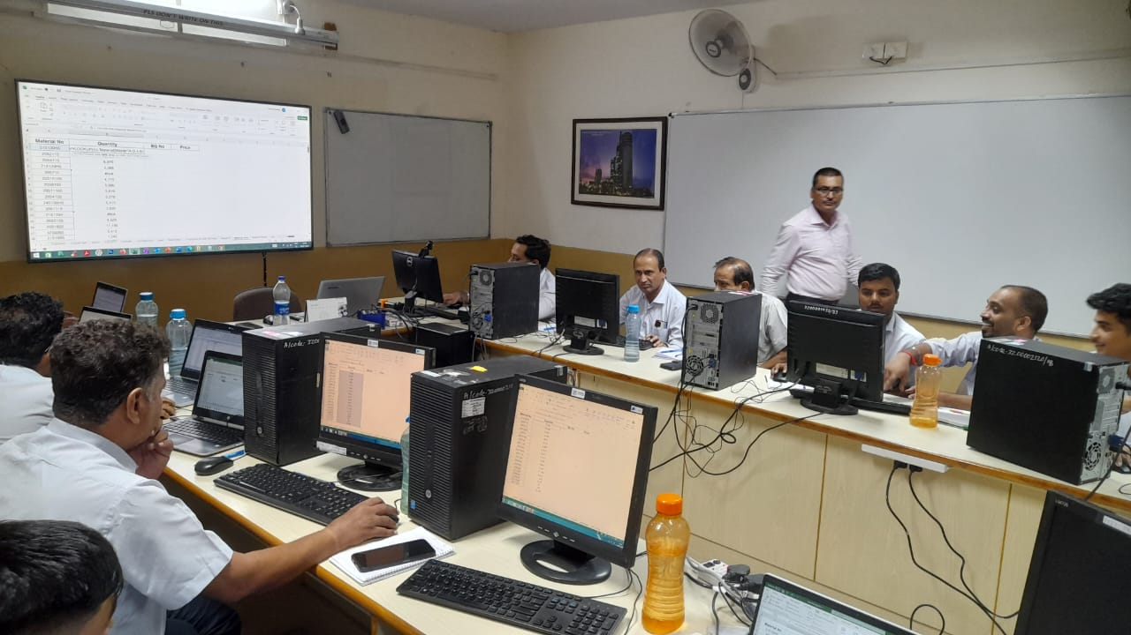

Slide 13



Slide 14
Agenda
Introduction to tools and Terminology
Dashboard in Minutes.
Power BI Products
Getting and Transforming data with Power BI Desktop
  Introduction to Power BI Desktop
  Setup and Manage Relationship
  Data Transformation
  Creating Measures
  Creating Calculated Fields
Power BI Desktop Visualization
Colour Formatting , Slicer, Hierarchies, Conditional Formatting’s
MAP Visualization, Custom Visuals, Grouping & Binning, Tree MAP, Word Cloud
Funnel Chart, Water Fall Chart, Donut Chart, Ribbon Chart and Etc……

Slide 15
Agenda
Introduction to DAX (Data Analysis eXpression)
Publishing & Sharing
Publish from Power BI desktop, Publish to web,
Share Dashboard to with Power BI Services
Workspaces & Apps
Publishing for Mobile Apps
Refreshing Data Set
Replacing a data set
Power Bi & Excel together
Options for Publishing from Excel

Slide 16
Power BI
Power BI is a cloud-based business analytics software
Fast and easy access to your data
Insights from any device
Collaboration across your organization
Anyone to visualize and analyze data
Notes:
Self-service business intelligence (BI) is an approach to data analytics that enables business users to access and work with corporate data even if they do not have a background in statistical analysis, BI or data mining.

Slide 17
Power BI
It is Design & Developed by Microsoft.
It provides interactive visualizations with self-service business intelligence capabilities, where end users can create reports and dashboards by themselves.
Power BI was first released to the general public on July 24, 2015
Notes:
Self-service business intelligence (BI) is an approach to data analytics that enables business users to access and work with corporate data even if they do not have a background in statistical analysis, BI or data mining.

Slide 18




The following are the top self-service analytical and BI platforms
Tableau offers interactive data visualization products based on business intelligence. The software offers colour, animation and cartography expertise to make data visualizations as easy as possible.
Qlik is inspired from PC-based desktop “Quick View” and was initially termed as Quality Understanding Interaction, Knowledge. Qlik is an established name in the data visualization, BI and analytics space and offers an array of products.
SAS (Statistical Analysis System) is a software suite developed by SAS Institute for advanced analytics for multivariate analyses, business intelligence, data management,
Salesforce Einstein is an artificial intelligence technology that had been developed for the Salesforce customer success platform.

Slide 19
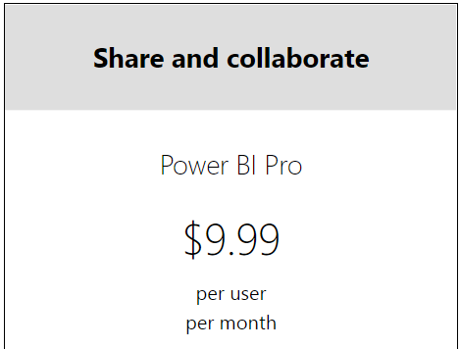
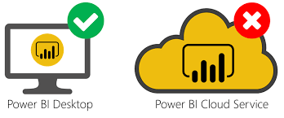
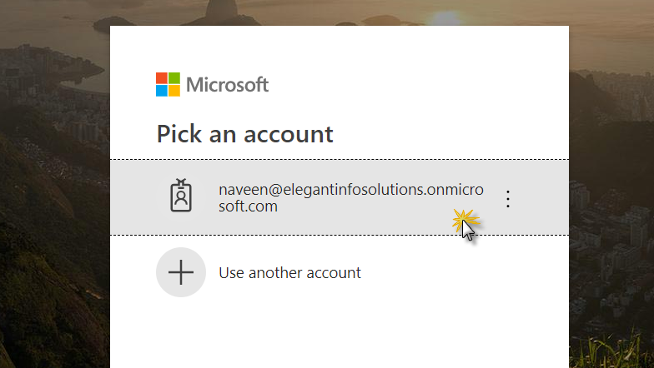
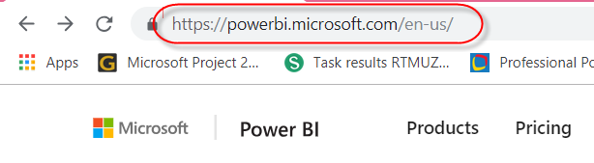
Power BI Products & Services
Desktop based interface, called "Power BI Desktop".
Power BI provides cloud-based BI services, known as "Power BI Services"

Slide 20
Power BI Products
Power BI Mobile Apps
The Power BI Mobile apps for Android and iOS devices, as well as for Windows phones and tablets.
Power BI Gateways
A Power BI gateway is software that you install within an on-premises network. Gateways used to sync external data in and out of Power BI.
Power BI Report Server
Provides a localized way for storing and managing Power BI reports.

Slide 21
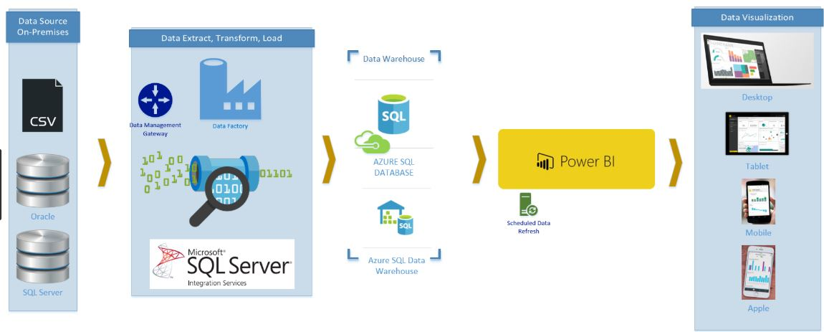

Power BI

Slide 22
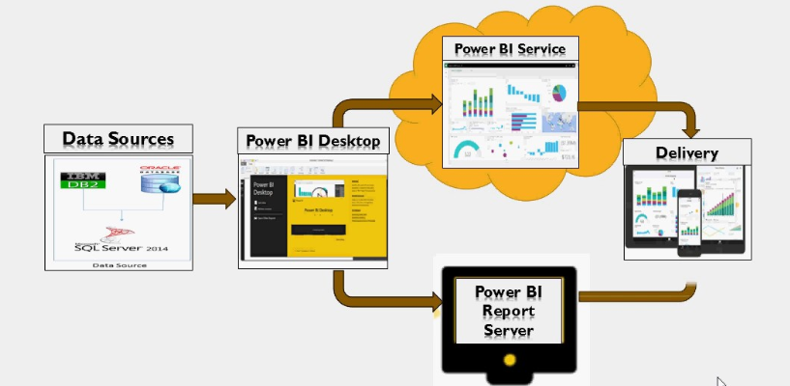
Power Bi Architecture

Slide 23
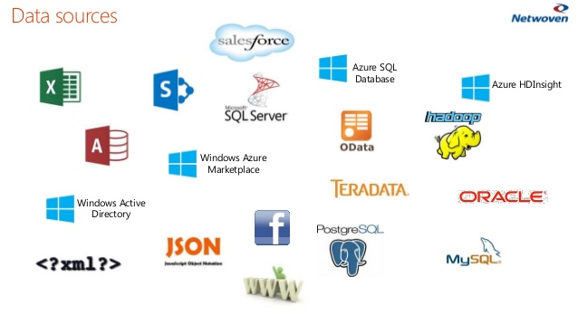
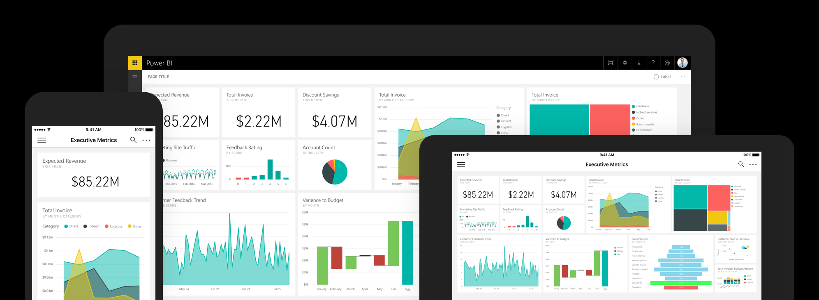
With both desktop and mobile interfaces, as well as cloud-based services, Power BI enables you to
Connect to hundreds of data sources
Produce visually impactful, easy-to-read reports
Share information across web and devices
Create personalized dashboards
Reduce your dependency on IT
Securely scale across your enterprise

Slide 24


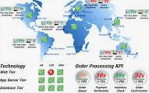

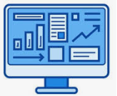
Building Blocks
For a Power BI consumer, the 5 building blocks are visualization,
dashboards, reports, apps and dataset ?
Get data
Create visualizations and reports
Create dashboards
Create apps and share with others
Analyze, monitor, make business decision

Slide 25
Power BI
Build rich, live dashboards that turn BI into business insights
Real-time with support for streaming data and alerts
Discover new insights with drill through capabilities
Stay connected from any device

Slide 26
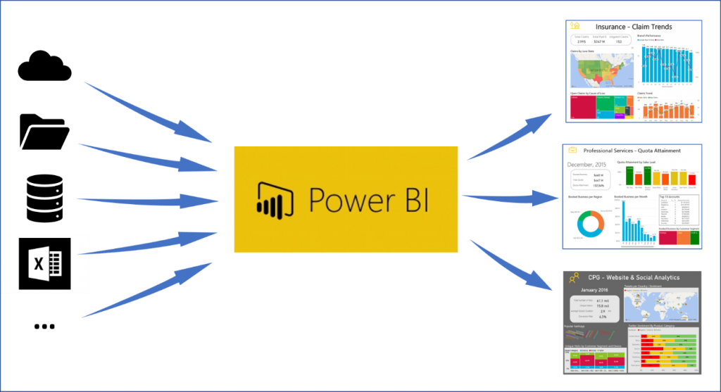
Power BI
Connect to hundreds of data sources, and visualize all your data with live dashboards and reports.

Slide 27
Power BI Ecosystem:
Power BI Desktop - A Windows desktop application
Power BI Services - An online SaaS (Software as a Service) service (formerly Power BI for Office 365, now PowerBI.com )
Power BI Apps - Mobile apps for Windows phones and tablets, as well as for iOS and Android devices
Power BI Gateways - To sync external files with Power BI, you need to install Gateway on your machine, and sign-in to authenticate the data refresh
Power BI Report Server - Provides a localized ways for storing and managing Power BI reports.
Power BI Visual Gallery - A gallery of pre-created custom visuals and R-powered visual.

Slide 28
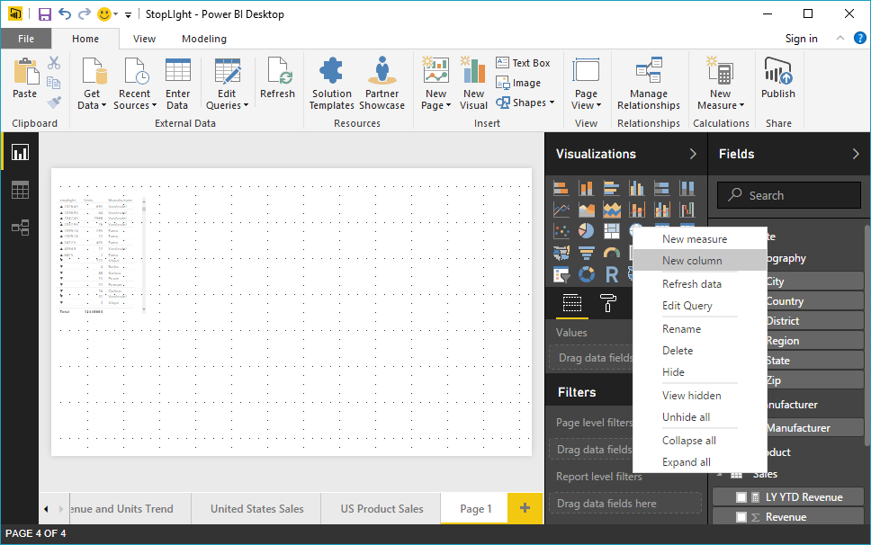
Key components of the power BI ecosystem
Power BI Desktop
  The Windows-desktop-based application for PCs and desktops.

Slide 29
Workflow of Power BI Desktop
Power BI Desktop
Data Preparation
Data Modelling
Data Visualization
Query
Editor (Power Query)
Relationship View
Data View
Report View

Slide 30
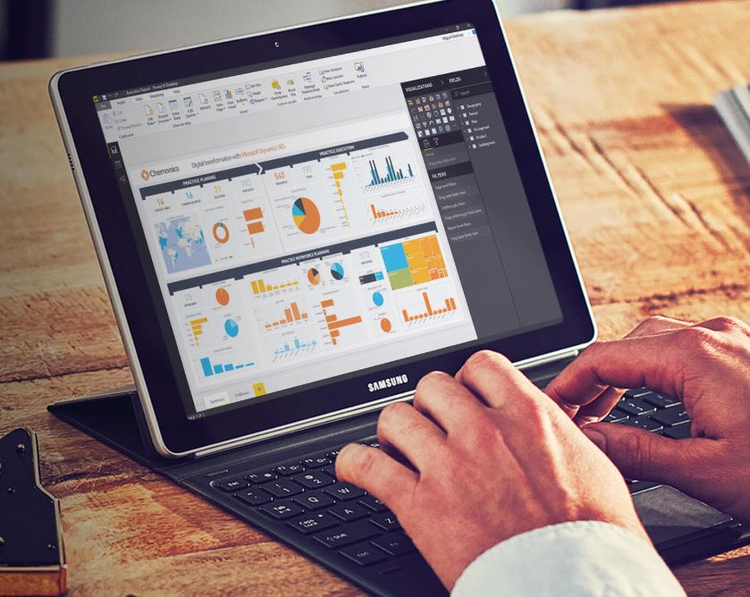
Demo

Slide 31
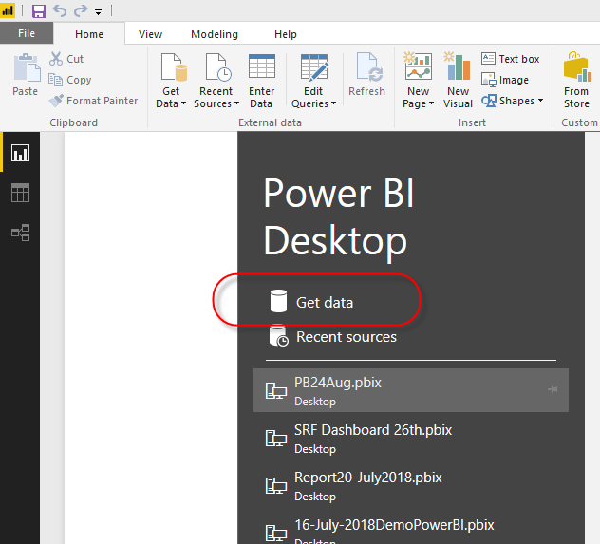
Using Power BI Desktop
Connecting to a database

Slide 32
Data Modeling
Data Modeling is one of the features used to connect multiple data sources in BI tool using a relationship.
A relationship defines how data sources are connected with each other and you can create interesting data visualizations on multiple data sources.
Open Order Excel file and do the demo

Slide 33
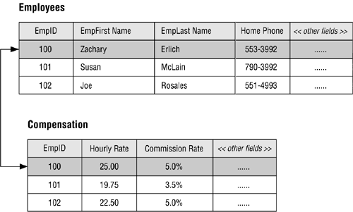
Type of Relationship
One to One
One to Many
Many to One

Slide 34
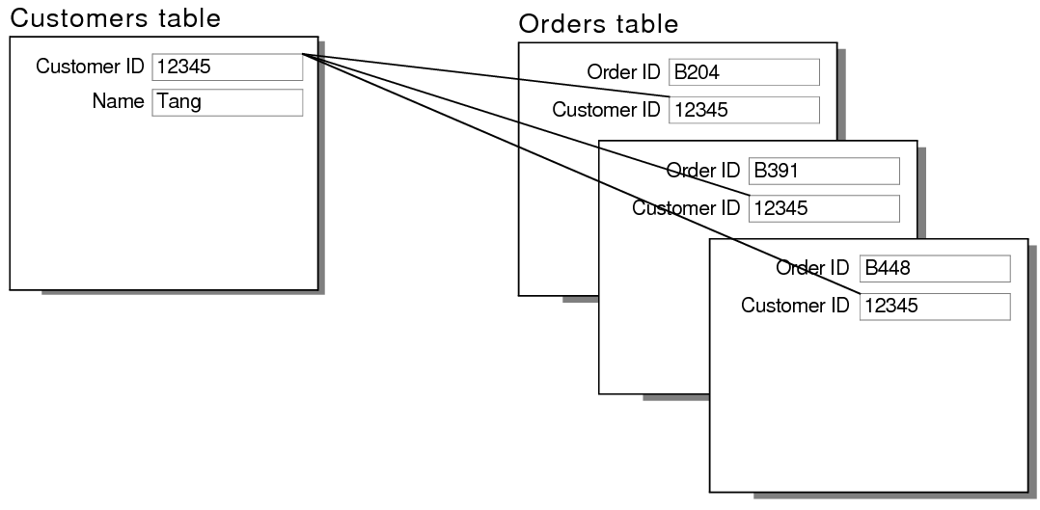
Type of Relationship : One to Many Or Many to One

Slide 35
Data Modeling
Click on Get Data, and then Select Excel Datasources
Load Order.xlsx File
Check the Relationship
Create Calculated Column - Invoice Amount = [Sales Amount]+ [Tax Amount]
Create Measure- Total Sales = Sum(OrderDetails[Sales])

Slide 36
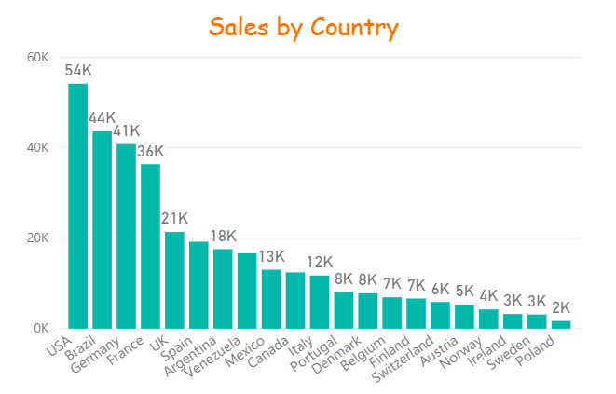
Column Chart
A column chart is a graphic representation of data. Column charts display vertical bars going across the chart horizontally, with the values axis being displayed on the left side of the chart.

Slide 37
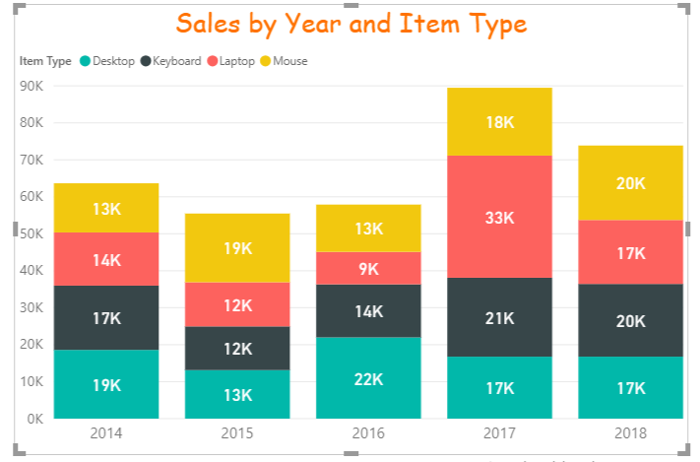
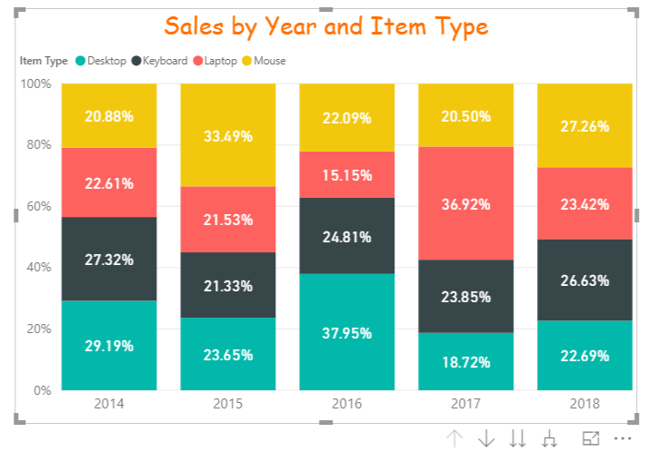
Stacked column chart/100% Stacked column chart
In a stacked column chart, data series are stacked one on top of the other in vertical columns.
Stacked column charts can show change over time because it's easy to compare total column lengths.

Slide 38
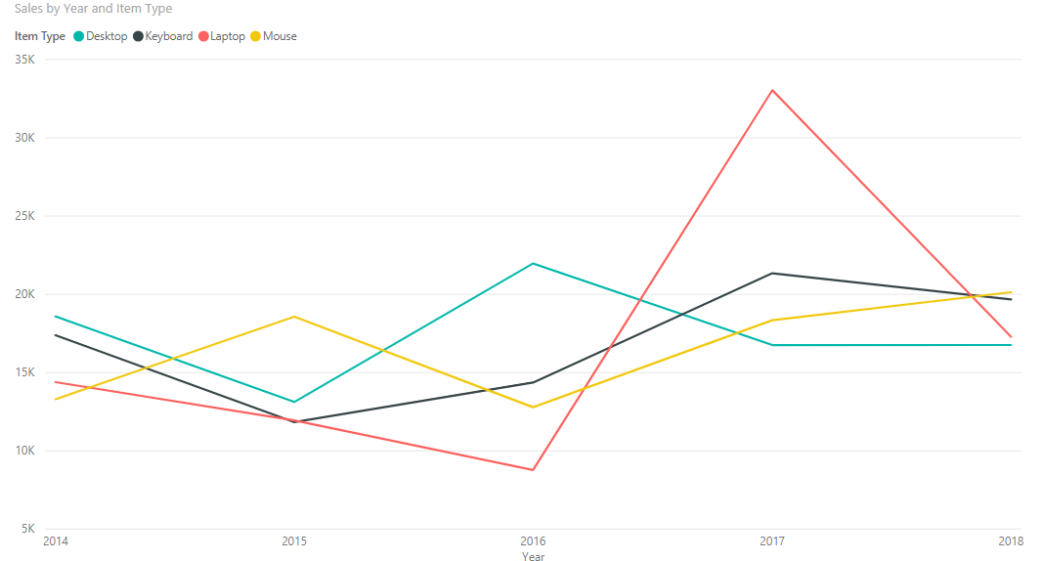
Line Chart

Slide 39
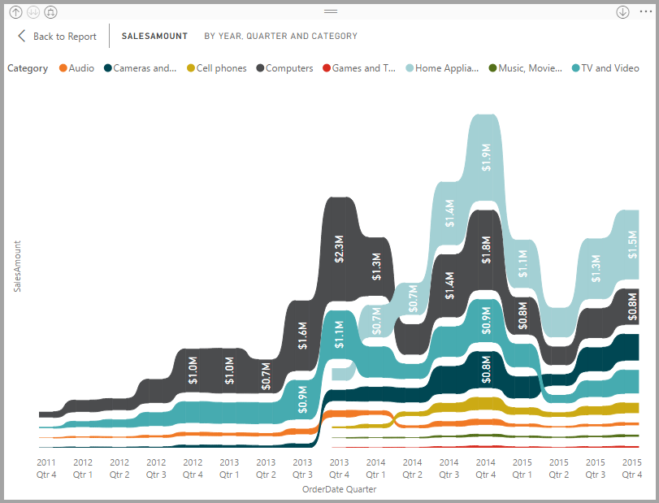
Ribbon charts
Ribbon charts are used to visualize data, and quickly discover which data category has the highest rank (largest value).
Ribbon charts are effective at showing rank change, with the highest range (value) always displayed on top for each time period.

Slide 40
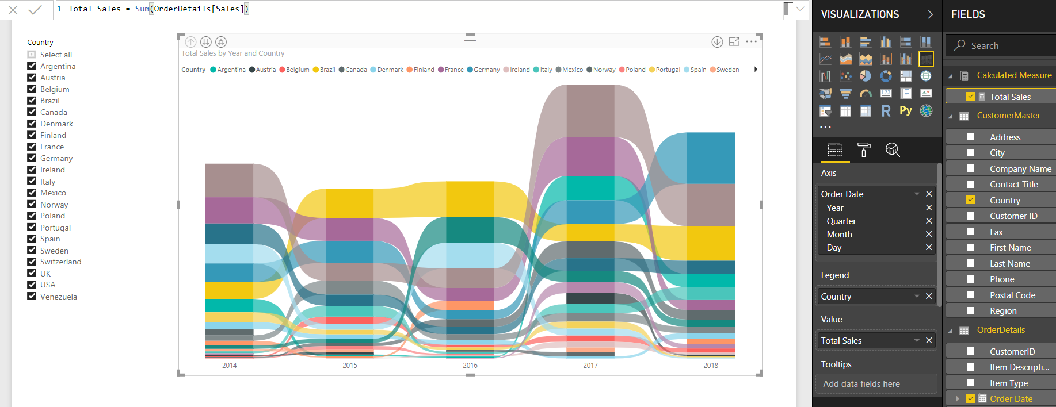
Create a ribbon Chart

Slide 41
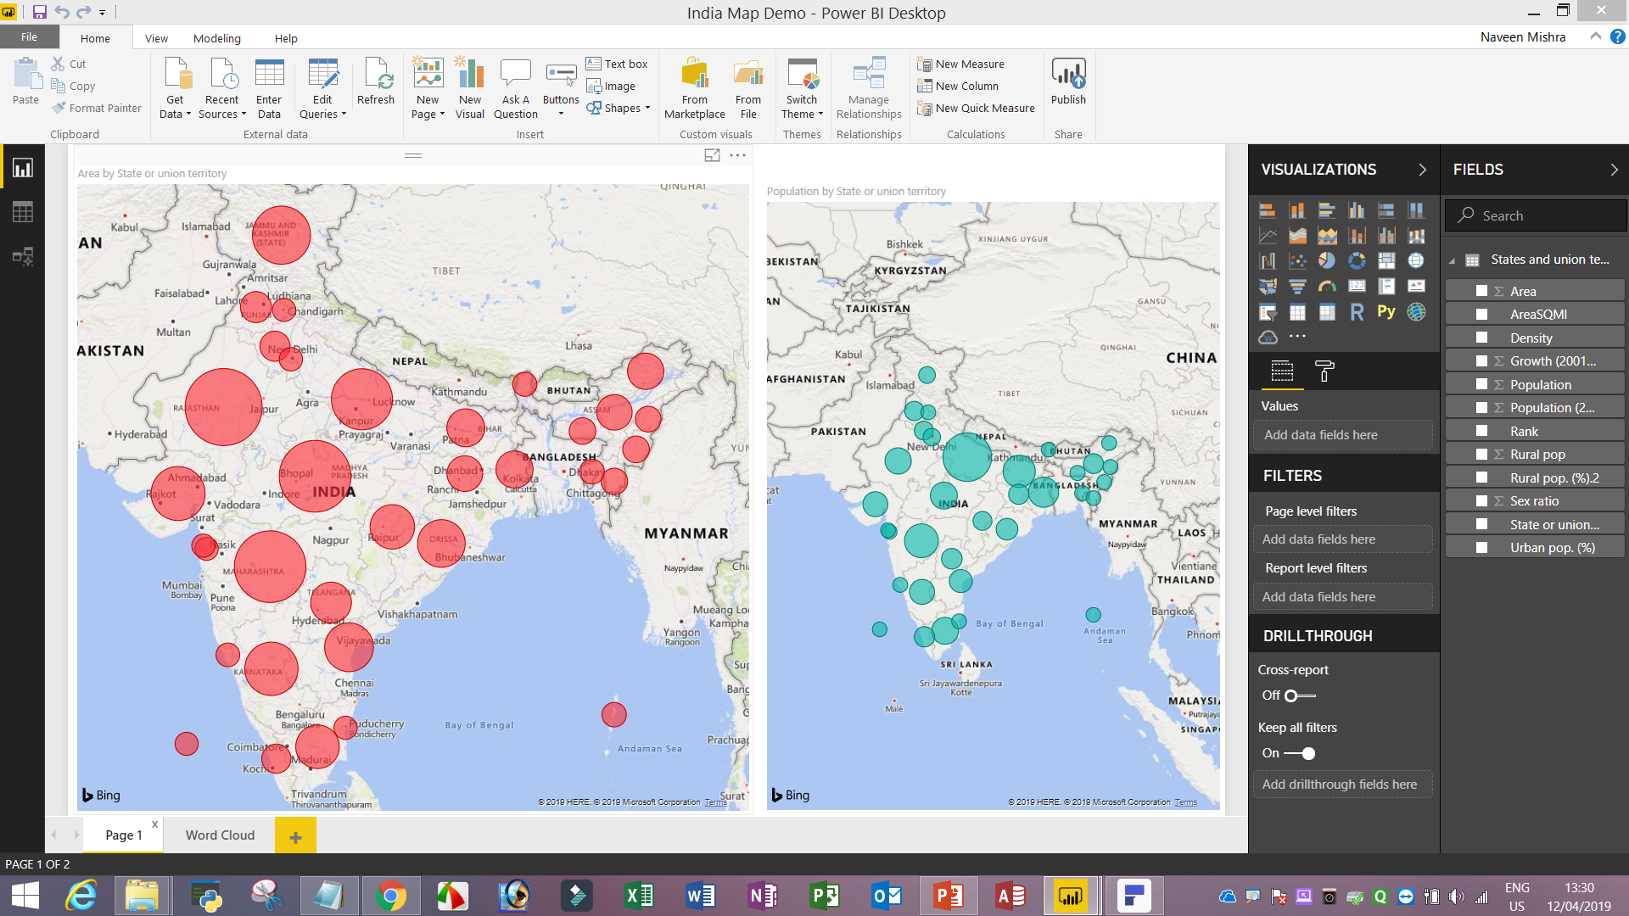
Import data from Web transform data and create Map India State wise

Slide 42
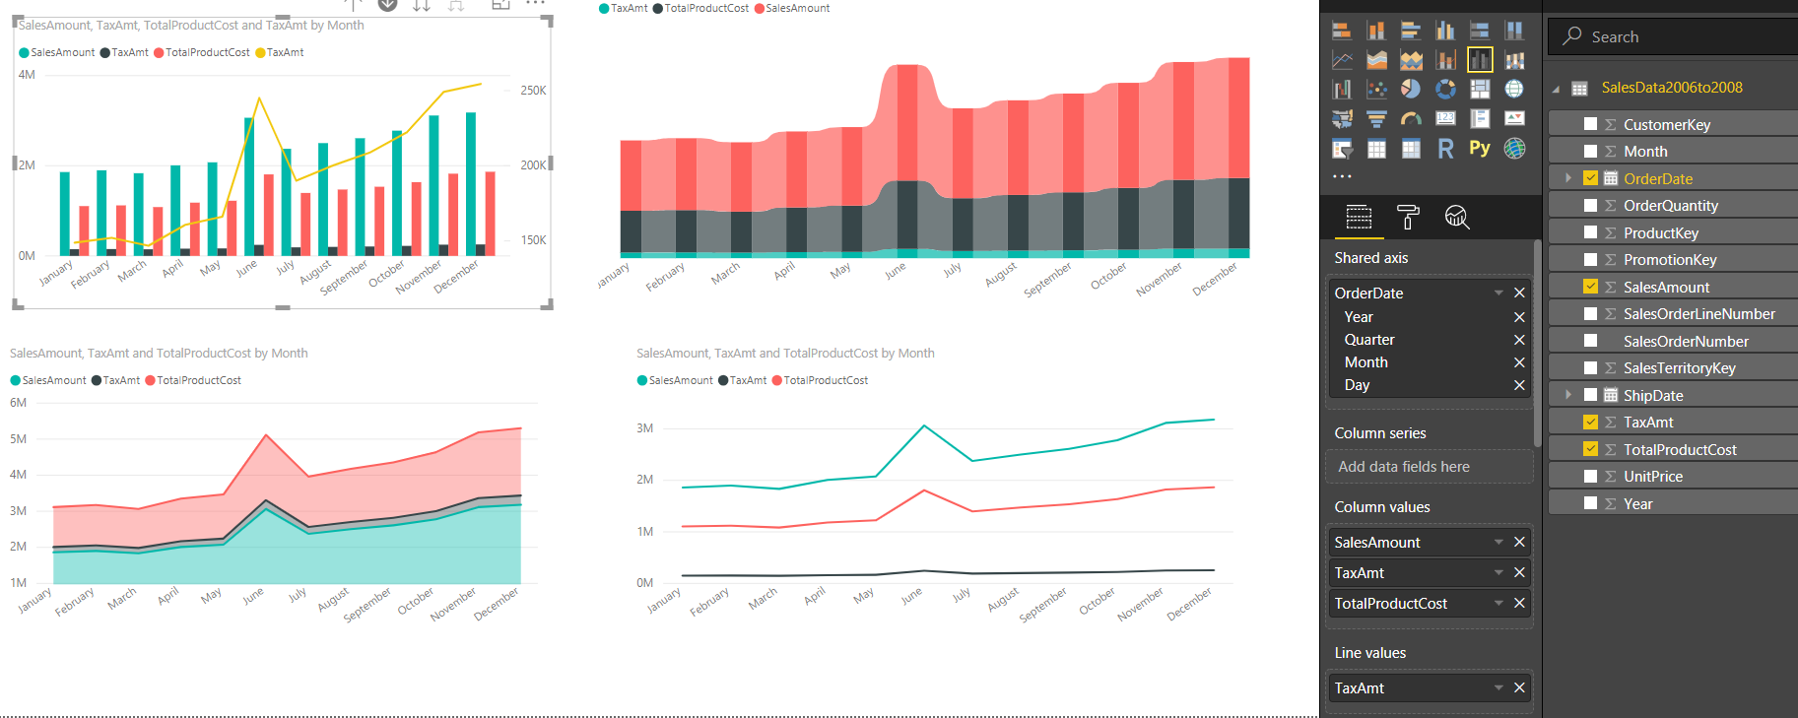
Import data from Power Query folder SalesData2006to2008 and create Various type of Line, Area Chart, Dual Axis, Ribbon chart

Slide 44
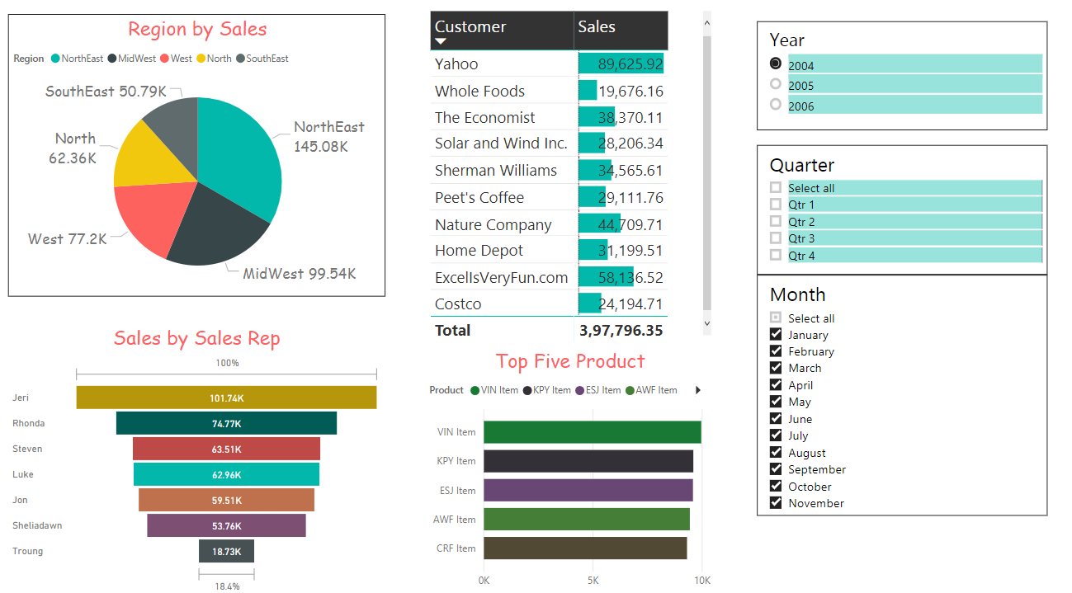
Assignment
Import data from Power Bi -> Power Query -> Sales Rep Raw data Folder and combined/Transform data and create dashboard.

Slide 45
Waterfall, Guages, Funnel Chart
Click on Get Data, and then Select Excel Data source
Verify the data, and click on Load.
Load the Sales_Data_ChannelType.xlsx File.
Waterfall - click on Department, and Sales Amount. Notice various properties of this chart.
Funnel - click on Department, and Sales Amount. Notice various properties of this chart. Sort by Sales Amount.
Gauge - Select Sales Cost, and Sales Amount to display the values. Notice various properties of this chart.

Slide 46
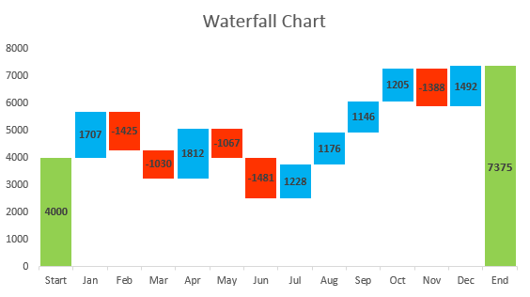
Waterfall chart
A waterfall chart is a form of data visualization that helps in understanding the cumulative effect of sequentially introduced positive or negative values.
These intermediate values can either be time based or category based.

Slide 47
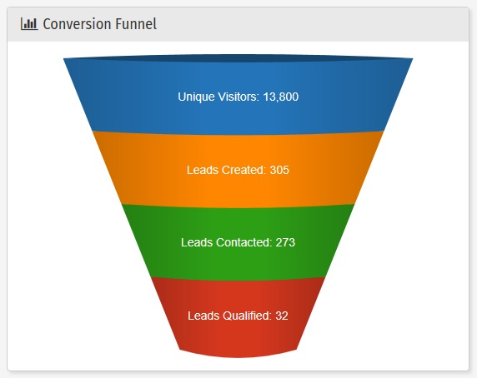
Funnel chart
Funnel charts are a type of chart, often used to represent stages in a sales process and show the amount of potential revenue for each stage.
This type of chart can also be useful in identifying potential problem areas in an organization’s sales processes.
A funnel chart is similar to a stacked percent bar char

Slide 48
Gauge charts
Gauge charts, also known as dial charts or speedometer charts, use needles to show information as a reading on a dial.
On a gauge chart, the value for each needle is read against the coloured data range or chart axis.
This chart type is often used in executive dashboard reports to show key business indicators.

Slide 49
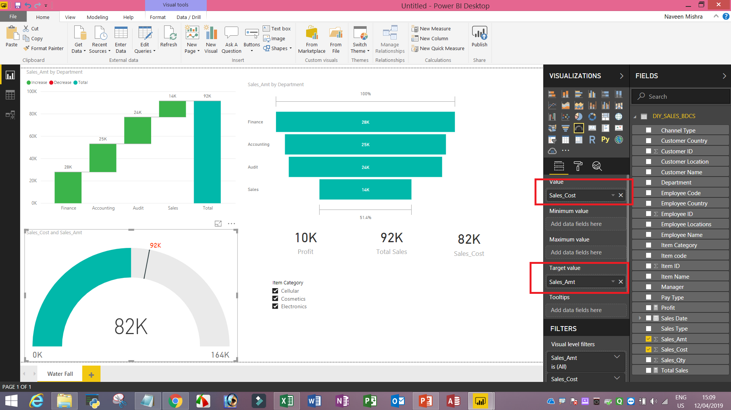
Gauge charts

Slide 50
Create New Hierarchy
Steps to Create New Hierarchy
1) Right Click on the customer Country and click new hierarchy.
2) Rename the Hierarchy to Customer Geography.
3) Right Click on the Customer Location -> Add to Hierarchy -> Customer Hierarchy and Add Customer Name also.
4) Add this Hierarchy in the column chart and add sales cost.
------------------------------------------------------------------------------------
Hands On Exercise
-------------------------------------------------------------------------------------
1) Create a Department Hierarchy using Department-> Manager-> Employee Name
2) Use this Hierarchy in waterfall chart.
3) Create a product Heirarchy using Item Category -> Item Name
4) Create a funnel chart using Hierachy.
5) Notic the various drill down options.

Slide 51
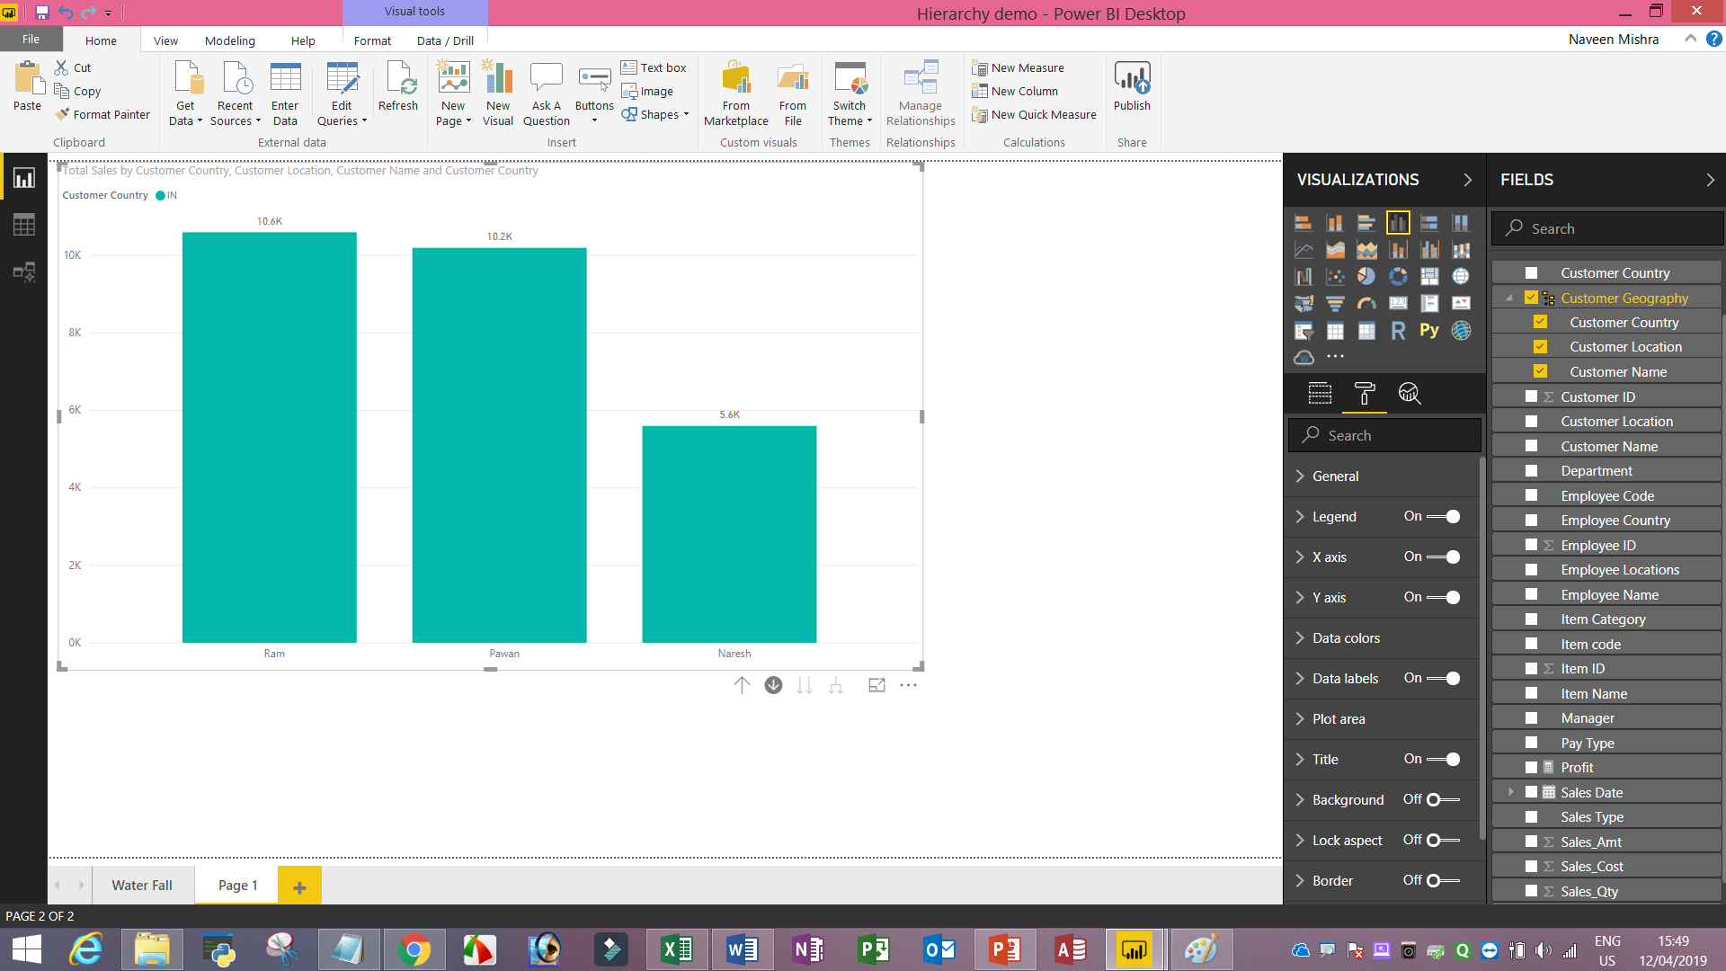

Slide 52
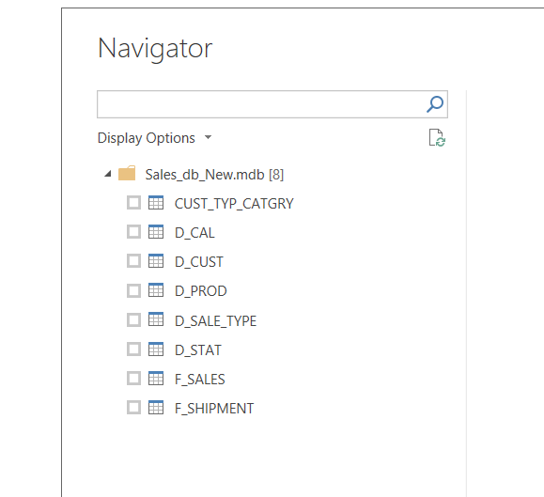
Import data from MS Access
Import table from MS Access [Sales_DB]

Slide 53
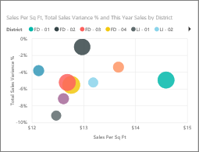
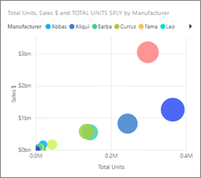
Scatter/Bubble Chart
A scatter chart always has two value axes to show one set of numerical data along a horizontal axis and another set of numerical values along a vertical axis. The chart displays points at the intersection of an x and y numerical value, combining these values into single data points. These data points may be distributed evenly or unevenly across the horizontal axis, depending on the data.
A bubble chart replaces data points with bubbles, with the bubble size representing an additional dimension of the data.

Slide 54
When to use a scatter chart or bubble chart
To show relationships between 2 (scatter) or 3 (bubble) numerical values.
To plot two groups of numbers as one series of xy coordinates.
Instead of a line chart when you want to change the scale of the horizontal axis
To turn the horizontal axis into a logarithmic scale.
To display worksheet data that includes pairs or grouped sets of values. In a scatter chart, you can adjust the independent scales of the axes to reveal more information about the grouped values.
To show patterns in large sets of data, for example by showing linear or non-linear trends, clusters, and outliers.
To compare large numbers of data points without regard to time. The more data that you include in a scatter chart, the better the comparisons that you can make.

Slide 55
Introduction to DAX

Slide 56
What is a measure in power bi?
In Power BI, a defined calculation is called a measure.
For example sums, averages, minimum or maximum values, counts,
or more advanced calculations you create yourself using a DAX formula
With DAX you can define a measure of time once, and then slice it by as many different fields as you want from your data model.

Slide 57
DAX (Data Analysis and EXpression)
Data Analysis Expressions is the native formula and query language for Microsoft PowerPivot, Power BI Desktop and SQL Server Analysis Services.
There are two types of calculations in DAX:
  Calculated Columns
  Calculated Measures
  Calculated column created time of data load. It is stored as part of table.
  Measures: Its not store during the processing of data means load of data. It is calculated on fly means it is created based on the context.

Slide 58

Calculated Column
Create a Calculated Column sales.
  Sales = [Unit_Price] * [Qty]
Create another calculated column
  Cost = [Unit_Cost] * [Qty]
Create a calculated column for Sales-to-Cost Ratio = [Sales] / [Cost]
Hands on
1- Create a calculated column for Gross Profit = [Sales] – [Cost]
2- Create column chart depicting Sales, Cost and Profit.
Hands on
1- Create a Calculated Column to do Shipment_Price = UNT_PRICE * QTY
2- Create a Calendar Table

Slide 59
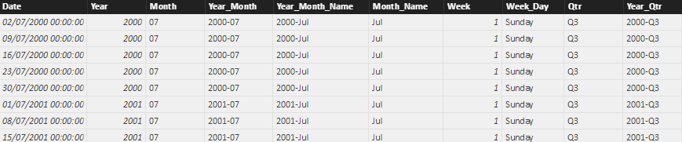
Create a Calendar Table
Create a Calendar Table.
Goto Data on the left side. Click on the Modeling menu tab on the top.
Click on New Table.
D_Calendar = ADDCOLUMNS ( CALENDAR (DATE(2000,1,1), DATE(2049,12,31)),
"Year", YEAR ( [Date] ),
"Month", FORMAT ( [Date], "MM" ),
"Year_Month", FORMAT ( [Date], "YYYY-MM" ),
"Year_Month_Name", FORMAT ( [Date], "YYYY-mmm" ),
"Month_Name", FORMAT ( [Date], "mmm" ),
"Week", WEEKDAY ( [Date] ),
"Week_Day", FORMAT ( [Date], "dddd" ),
"Qtr", "Q" & FORMAT ( [Date], "Q" ),
"Year_Qtr", FORMAT ( [Date], "YYYY" ) & "-Q" & FORMAT ( [Date], "Q" ))

Slide 60
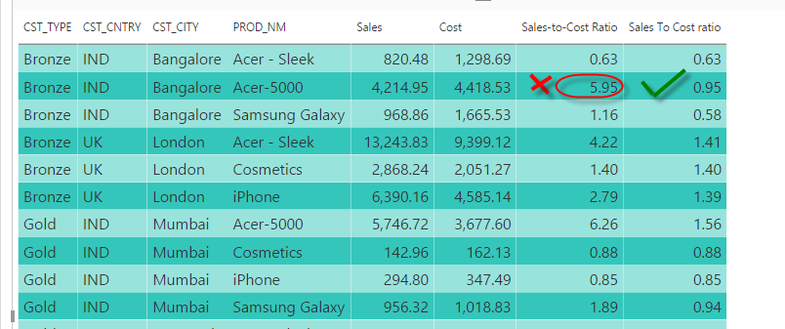
Create Calculated Measure using SUM function
Create a calculated measure for Sales To Cost ratio = Sum(F_SALES[Sales])/Sum(F_SALES[Cost])

Slide 61
SUMX, COUNTX and AVERAGEX DAX function
Create a list with Customer Type Category, Qty, Customer Country.
Filter Qty only for the Gold customers.
Let's do this measure calculation:
SumFilterGold = SUMX(FILTER(F_SALES,RELATED(CUST_TYP_CATGRY[CST_TYPE])="Gold"),F_SALES[QTY])
To figure out the number of gold customers, use the following measure calculation:
CountFilterGold = COUNTX(FILTER(F_SALES,RELATED(CUST_TYP_CATGRY[CST_TYPE])="Gold"),F_SALES[QTY])
Let's create an avg: [SumFilterGold] / [CountFilterGold]

Slide 62
RANKX
Returns the ranking of a number in a list of numbers for each row in the table argument.
RANKX(<table>, <expression>[, <value>)
Eg:- 1) Create a sample table with CustID, Sales, Cost.
2) Create a measure calculation for Gross_Profit_C.
3) Gross_Profit_C = Sum(F_SALES[Sales])-sum(F_SALES[Cost])
4) Create a Rank Measure.
Rank = RANKX(all(F_SALES[CUST_ID]),[Gross_Profit_C],,0)

Slide 63
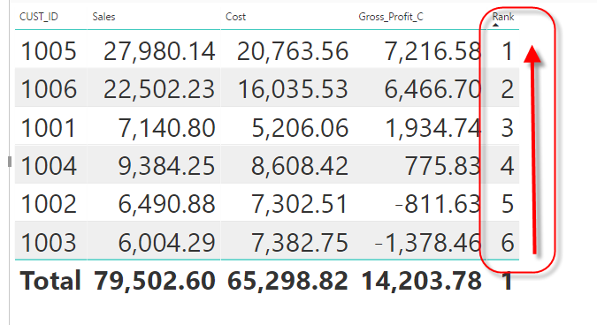
RANKX DAX Function

Slide 64
Drill Throughs
With drillthrough in Power BI Desktop, you can create a page in your report that focuses on a specific entity such as a supplier, customer, or manufacturer.
Users can right-click on a data point in other report pages.
They can drill through to the focused page to get details that are filtered to that context.

Slide 65
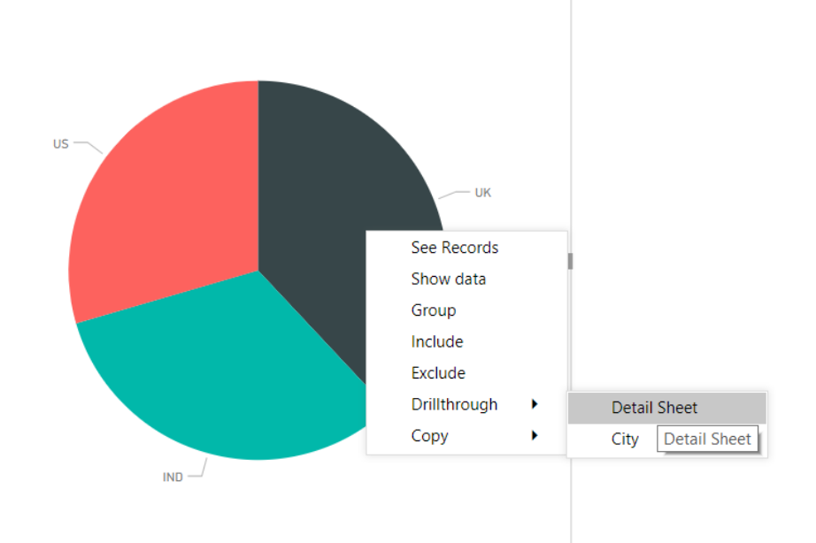
Step to create Drill Throughs
Create a new sheet, and add a Pie chart with CST_CNTRY, Sales Amount(Column Name - Sales).
Now, create another sheet, and then add a simple table with CST_CNTRY, CST_CITY, CST_NM, Sales.
Add CST_CNTRY to the drill through filters area of the table.
Disable Keep-all option for now.
Go back to the sheet with the pie chart and right click any area, and then click on Drill through.

Slide 66
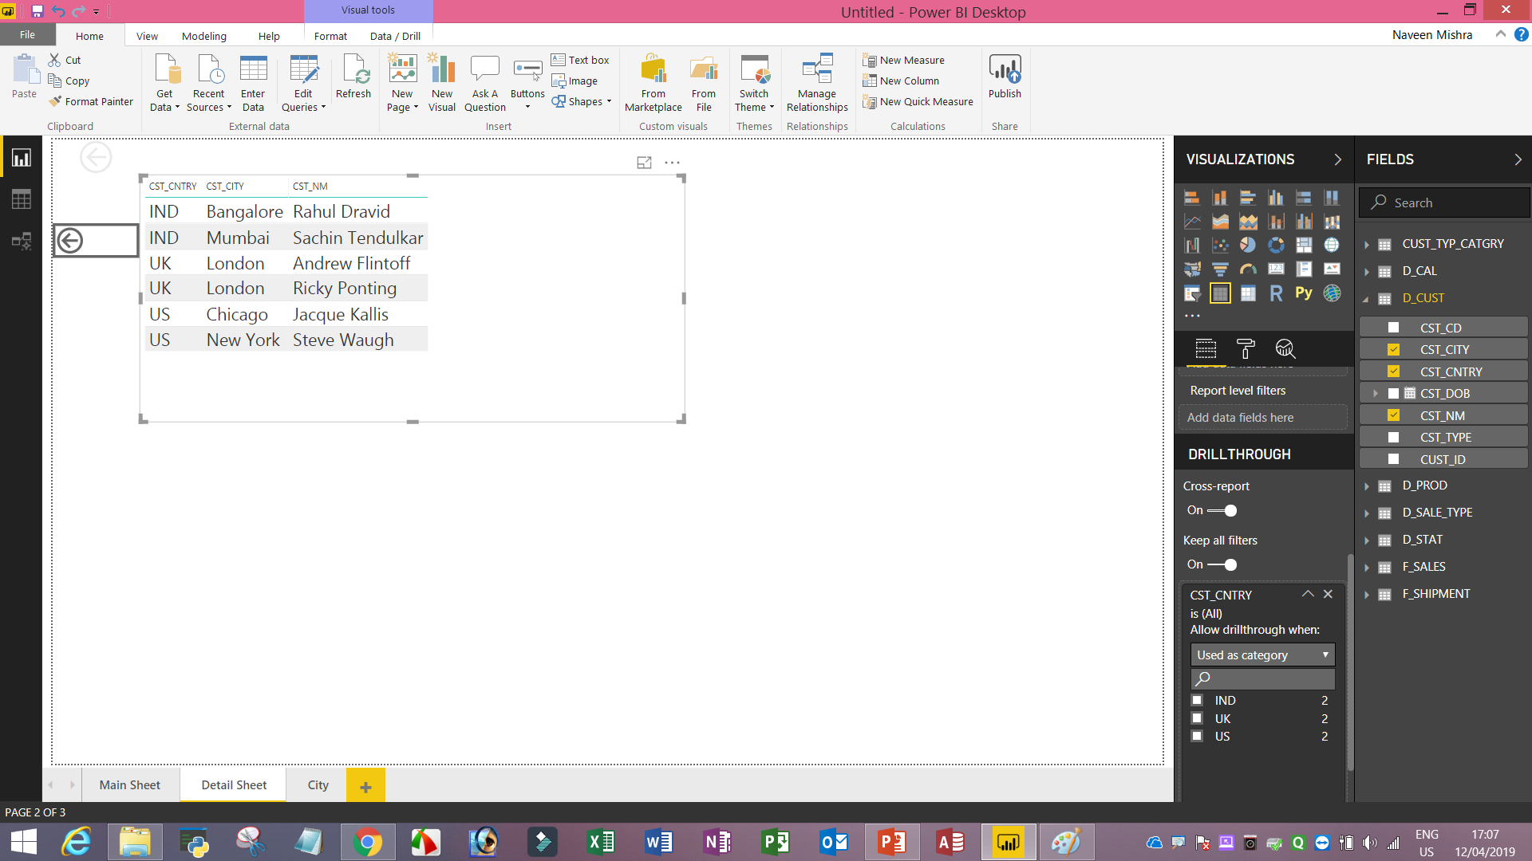

Slide 67
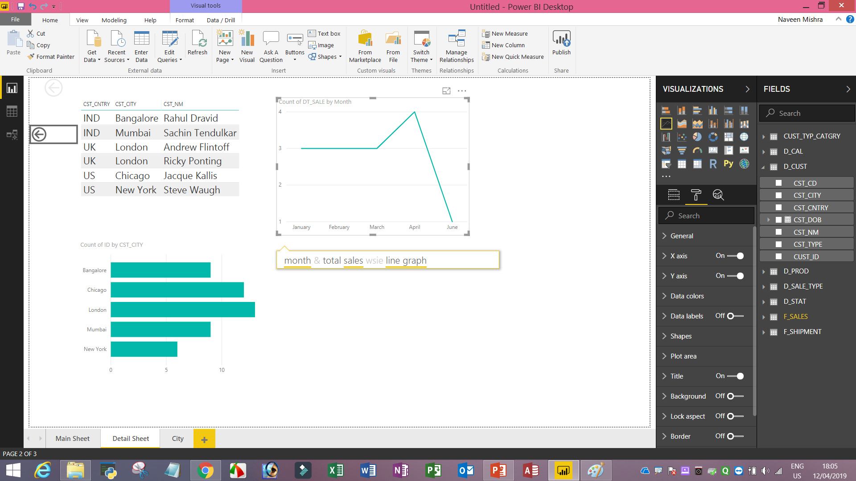
Ask a Question Functionality

Slide 68
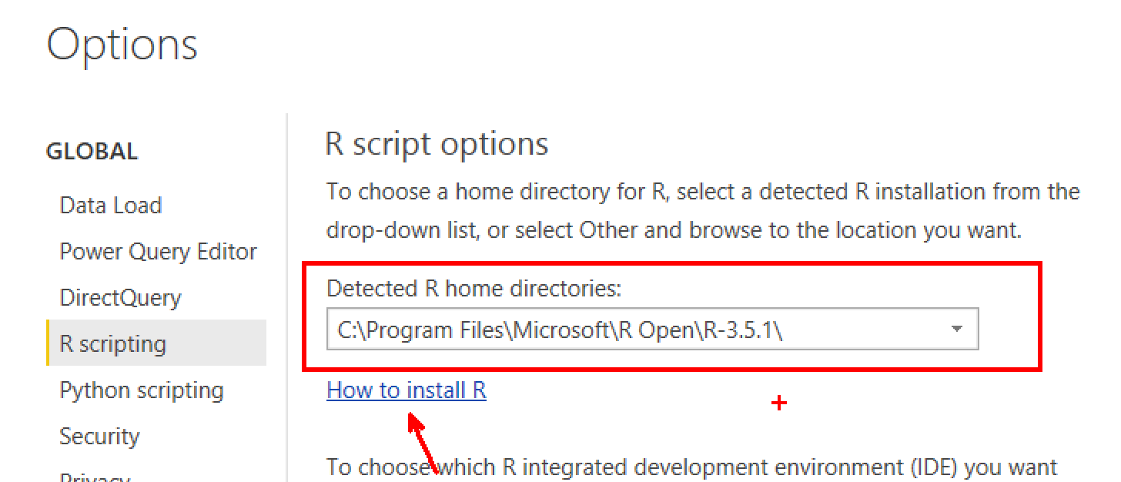
Integration with R
Power BI provides in-built integration with R. Let's see how to execute a R code.
Add the R visualization, and Select Department, Customer Name and Sales Amount.
Write the following code in R to create a histogram.
Colours = c("red", "yellow", "green", "orange", "blue", "pink", "cyan")
hist(dataset$Sales_Amt,col=colours)
If you are not able to run r code
first install R-Programming

Slide 69
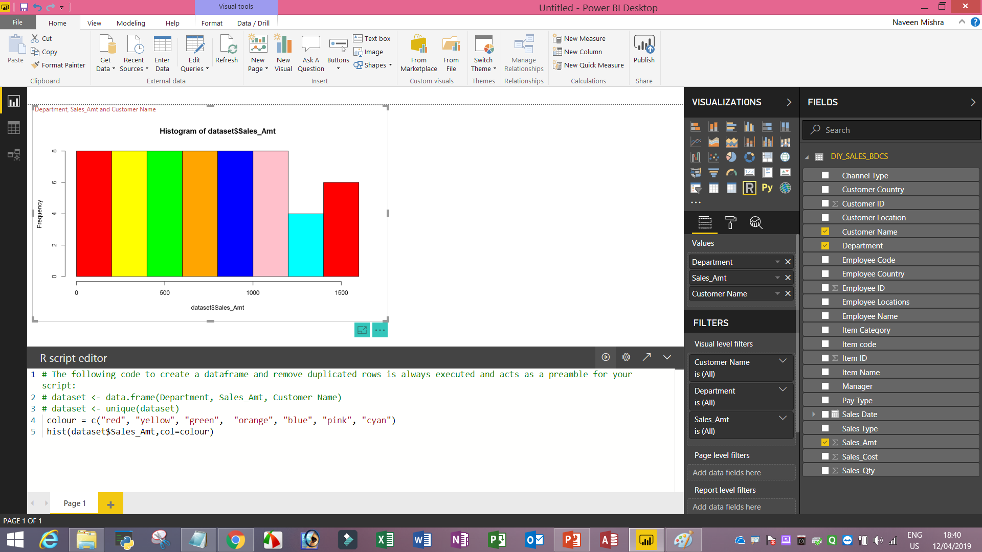
Run R-Code
Notes:
colour = c("red", "yellow", "green", "orange", "blue", "pink", "cyan")
hist(dataset$Sales_Amt,col=colour)

Slide 70
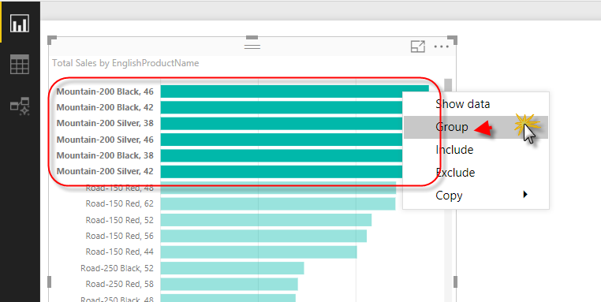
Data Grouping / Bins
Open data grouping demo file from demo folder.
Select first 6 Item right click and click on the Group

Slide 71
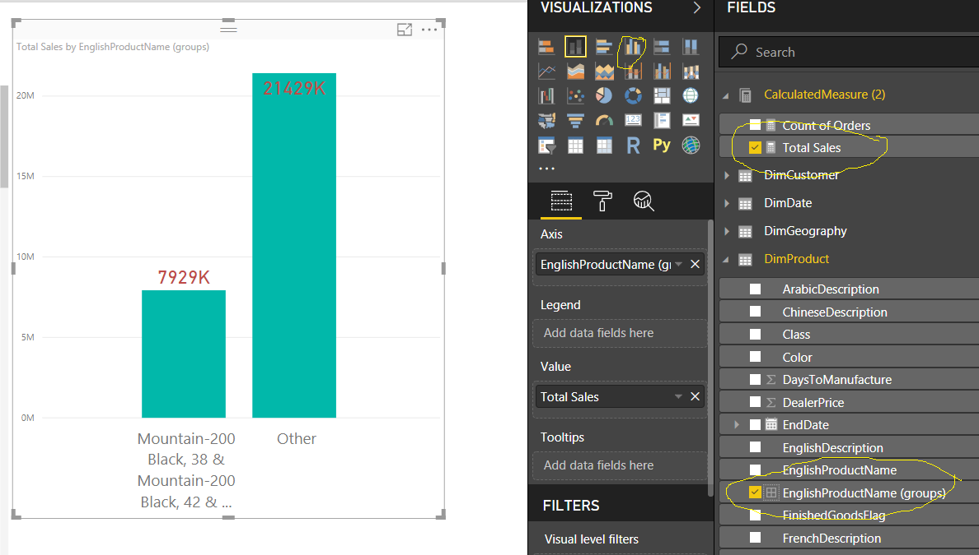
Data Grouping / Bins

Slide 72

Steps to Create Bins
Bins we can create on numeric value or date/time.
Select Sales Amount from factInternalSales Table and in modelling tab click new group.

Slide 73

Create Word Cloud

Slide 74

Conditional Formatting – Data bar

Slide 75

Create a sales analysis dashboard

Slide 76
In Power BI Desktop, it is easy to add background images.
In the Visualizations pane, on the Format tab, under Wallpaper / Page Background, just click the Add Image button.
Choose your image,adjust the Image Fit as necessary You are done!

Slide 77
What are the Differences Between Power BI Free, Power BI Pro and Power BI Premium?
Power BI Free
Power BI Free enables you to connect to 70+ data sources, publish to the web, and export to excel.
There are some limitations to the free version. For example, you can’t do peer-to-peer sharing and you can’t create App workspaces.
However, the free version is great if you are doing your own analysis and don’t need to distribute the analysis to other end users.
You also have connectivity options such as DirectQuery, live connection, and the use of the gateway. The same visualizations that are available in Power BI Pro are available in Power BI Free.

Slide 78
Power BI Pro
The biggest difference between Free and Pro is that with Pro you can share your data, reports, and dashboards with other users who also have a Power BI Pro license. You can also create App workspaces. Both Power BI Free and Pro have a 10 GB per Pro user data storage limit. Here is a screenshot from Microsoft’s Power BI website that summarizes the difference.

Slide 79


Slide 80
Power BI Premium
Power BI Premium is an on-premise deployment and distribution of Power BI reports using the Power BI Report Server. This allows you to maintain reports on-premise and move to the cloud when your organization is ready.
Power BI Premium is designed to address the challenges of large enterprise deployments and workloads. It enables your organization to use your own dedicated capacity and hardware rather than relying on Microsoft’s shared capacity.
You’ll need to provide that capacity and ensure you have enough for your reporting and analysis purposes. This allows for much larger scale and better performance if you size it properly. Microsoft offers three sizes for Premium capacity and each come with a different number of v-cores and memory size

